Slide 1
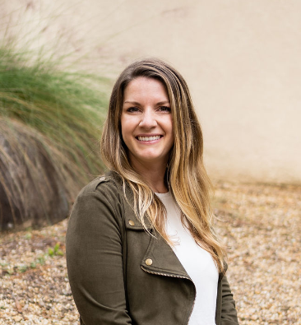
Sarah Mason Manager
Professional Experience:
Business Analyst - Client - Accenture Federal Services
Developed Prioritization framework across 6 tasks areas to streamline ad hoc requests
Defined stakeholder outreach across 10 sectors to include top major federal agencies such as Energy & EPA
Delivered VoC Strategy research synthesis and recommendations to improve CX for CISA customers
Engaged with top level Federal leadership to define client’s requirements and current state assessment
Business Process Designer - Client - Accenture Federal Services
Provided Process Design Mapping and Research supporting Welcome.US initiative to connect newcomers with work authorization to employment opportunities
Conducted research and analysis to identify current processes and challenge areas with a human centered approach
Delivered Executive level report including findings, solution recommendations and future considerations
Design Lead - Internal – Accenture LLP, CDAO
Developed/Delivered “Project” Complex Data Solution – enabled Overdue demand data for approx. 40% of the contracts under E2E delivery management
Established ADO Backlog, CDAO Intake requirement template and process
Program Manager Role– managed ADO Backlog for IT delivery across multiple PODs, PTO calendar, team engagements
OSINT Operations & Policy Subject Matter Expert​ - Client - Accenture Federal Services
Provided management & execution support on OSINT policy, tools, data, systems, and Digital Ecosystem budget management
Collected & refined requirements from end users, equity stakeholders, and higher headquarters to increase OSINT enterprise​ across 6 additional sites
Operations Coordinator - Non-Accenture – United States Air Force
Provides logistical, administrative, security and info management support for Defense Attaché Offices in Asia/Pacific Region
Prepares & edits reports for Desk Officers and analysts for national security collection missions
Background:
Sarah is a Business Architecture Manager in the Technology Practice. Sarah has experience in project management, process design, and client delivery. She has worked with Accenture leaders as well as large Defense and Federal clients on process improvements, resource management, and business development. Sarah can demonstrate innovative ways for clients to improve current business practices and is able to build meaningful client relationships.
Contact:
Sarah.D.Mason@AFS.com
281-468-9571
Skills:
Education:
Project/Program Management
Business Process Design & Analysis
Metrics and Status Reporting
Process Improvement
Resource Management
Design Thinking
B.S. Exercise Science – American Military University

